Slide 1
Meepo：Sharded Consortium Blockchain
Conference : ICDE’21
Author : Peilin Zheng, Quanqing Xu, Zibin Zheng, Zhiyuan Zhou, Ying Yan, Hui Zhang
Research unit : Sun Yat-sen University, Ant Group

Slide 2
Background & Problem
The performance of consortium blockchain cannot meet the requirement of applications. Sharding is one of the optional methods to improve blockchain performance. However, the previous sharding studies focus little on consortium blockchain, and they cannot meet the following practical requirements of consortium blockchain:
High cross-shard efficiency
Consortium blockchain requires complete ledger in practice and higher cross-shard efficiency than public blockchain.
Flexible smart contract calling
One contract on consortium blockchain might call the state in several shards and contracts.
Strict transaction atomicity
Atomicity should be ensured within one block.
Shard availability
The data on consortium blockchain is read and written by the members far more frequently than public blockchain, requiring higher availability.

Slide 3
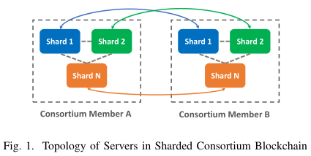
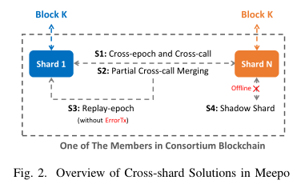
Solution
To solve the above problems in consortium blockchain sharding, we propose Meepo1, as its idea is to use Multiple Execution Environments Per Organization. The topology of servers in Meepo is shown in Figure 1, where each consortium member holds all the shards.
Cross-epoch and Cross-call
Partial Cross-call Merging Strategy
Replay-epoch
Shadow Shard Based Recovery

Slide 4
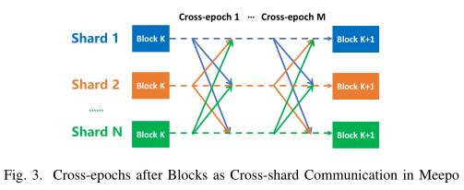
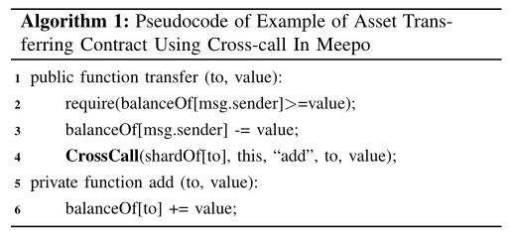
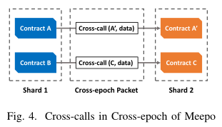
Challenge & Technique
Challenge 1：High cross-shard efficiency.
We cannot set up the account distribution to reduce the cross-shard communication, since the future user behaviors cannot be predicted.
Technique 1：Cross-epoch and Cross-call.
Since the communication just happens in the local
network of the consortium member, the network speed
can be fastened than the previous studies that are in the
Internet environment. Moreover, in one member, different
shards can trust each other because they belong to the same
consortium member.

Slide 5
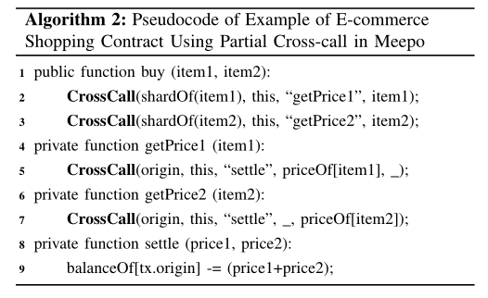
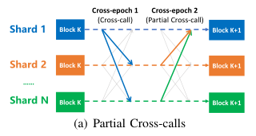
Challenge & Technique
Challenge 2：Flexible smart contract calling.
Technique 2：Partial Cross-call Merging Strategy.
This strategy improves the flexibility of smart contracts, enabling smart contracts to operate the state on different shards, even in parallel calls. Furthermore, it also enhances the cross-shard efficiency of some complex contracts.

Slide 6
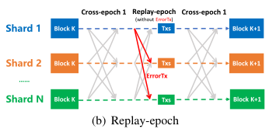
Challenge & Technique
Challenge 3：Strict transaction atomicity.
Technique 3：Replay-epoch.
The most important advantage of the method is that it ensures the transaction atomicity in the duration of one block. This is also benefited from the high efficient cross-shard communication.

Slide 7
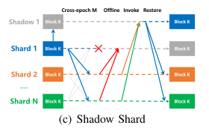
Challenge & Technique
Challenge 3：Shard availability.
A simple hot backup of data cannot solve this problem, since the synchronization and switching of backups need to maintain communication and consistency with other shards.
Technique 3：Shadow Shard Based Recovery.
The shadow shard copies the block and state from its master shard, without joining in the consensus or communication with other shards, but is known by others.

Slide 8
Evaluation Results
Setup
We implement Meepo on the Go-Ethereum, with Proof of Authority (PoA) protocol that can be used for consortium blockchain. We add an interface for batch submission of transactions to facilitate testing and improve performance. We run the Meepo-Geth on the experimental environment on Elastic Cloud Server (ECS), provided by AliCloud. Each blockchain peer is equipped with an Intel Xeon Platinum 8269CY CPU, 8 cores, 32GB RAM, and 900GB NVME SSD.

Slide 9
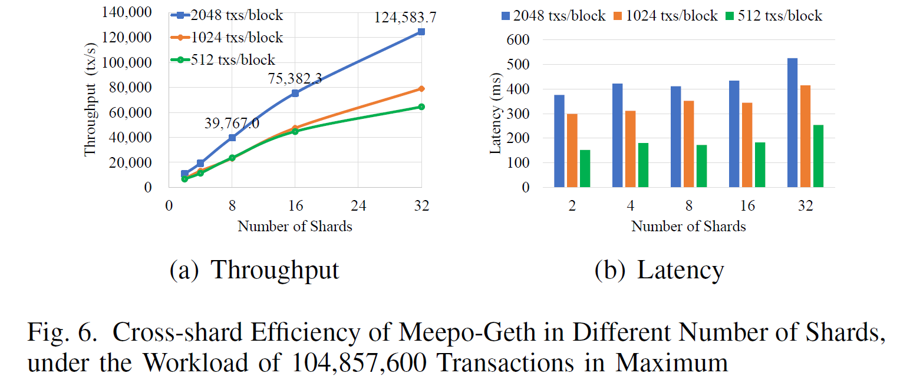
Evaluation Results
Cross-shard Efficiency.
we use four consortium members, and each one is equipped with shards from 2 shards to 32 shards per member, case by case. In this configuration, the number of processed cross-shard transactions is 32×2048×1600 = 104, 857, 600 in total, transferring the assets among 2048×1600 = 3, 276, 800 accounts.
When running with more blocks, the Garbage Collection (GC) in Golang becomes more significant, leading to a decrease in performance.

Slide 10
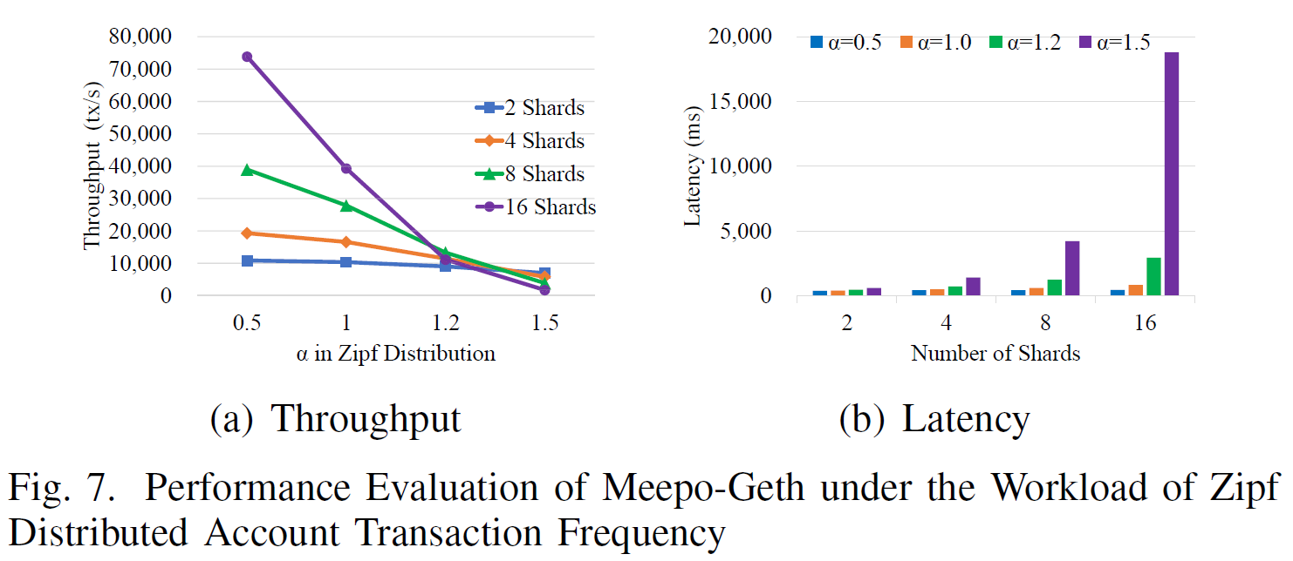
Evaluation Results
Cross-shard Efficiency.
In the real-world asset transferring, the frequency distribution of real-world accounts shows a Long-tailed distribution. We use P (r) = C/r^{α} to generate the Zipf distributed workload, where r represents the rank of an account, P is the probability of the account, C is a constant number, and α is a parameter. When the α grows, the scalability of shards declines, as the throughput drops faster with more shards. This is the so-called hot-spot account problem, which might be solved by upper load balancing in future work.

Slide 11
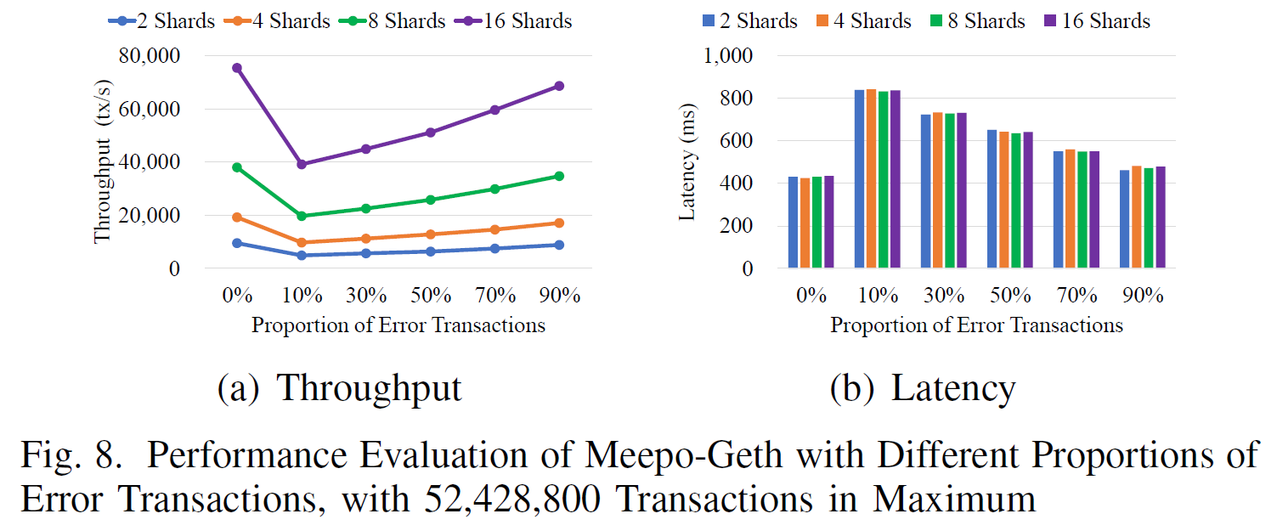
Evaluation Results
Consumption of Transaction Atomicity.
We run Meepo-Geth with some error transactions that will throw exceptions during the cross-epoch. During the workload generation, we insert the error transactions in different percentages of the total transactions. The percentage of errors is set to 0%, 10%, 30%, 50%, 70%, and 90%, respectively.

Slide 12
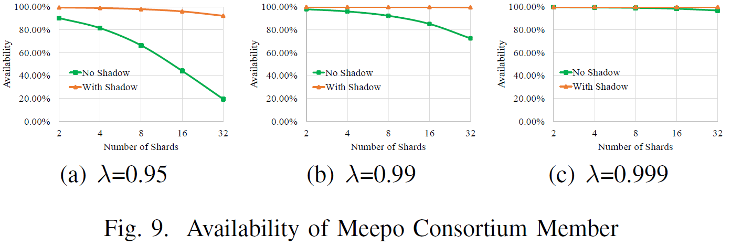
Evaluation Results
System Availability.
We mark the reliability of the single peer as λ. In this evaluation, the configurations are set to λ = 0.95, λ = 0.99, and λ = 0.999, respectively.

Slide 13
Conclusion
Sharding
1. Network Sharding
2. Transaction Sharding
The transactions of whole network are divided into different fragments for verification and packaging.
3. State Sharding
The state of the complete ledger is stored separately in each shard.
Problem
1. 51% attack in POW consensus
2. Additional overhead for cross-chip communication
3. Single point overheating problem
4. Dynamic adjustment of system state caused by changes in the number of shards and nodes

